Slide 1


Computer Applications to Behavioral Sciences
Lecture 18. Web development Homepage Example
https://psychology-courses.appspot.com/
Dr. Jibo He
Wichita State University
hejibo@gmail.com

Slide 2
Overview
Google Application Engine (GAE)
Setup GAE environment
Sign up (GAE)
Deploy your website in GAE

Slide 3

Google Application Engine (GAE)
Does one thing well: running web apps
Simple app configuration
Scalable
Secure

Slide 4

Why Not LAMP?
Linux, Apache, MySQL/PostgreSQL, Python/Perl/PHP/Ruby
LAMP is the industry standard
But management is a hassle:
Configuration, tuning
Backup and recovery, disk space management
Hardware failures, system crashes
Software updates, security patches
Log rotation, cron jobs, and much more
Redesign needed once your database exceeds one box
“We carry pagers so you don’t have to”
FREE

Slide 5
Setup GAE environment
Download and install
https://storage.googleapis.com/appengine-sdks/featured/GoogleAppEngine-1.9.14.msi

Slide 6
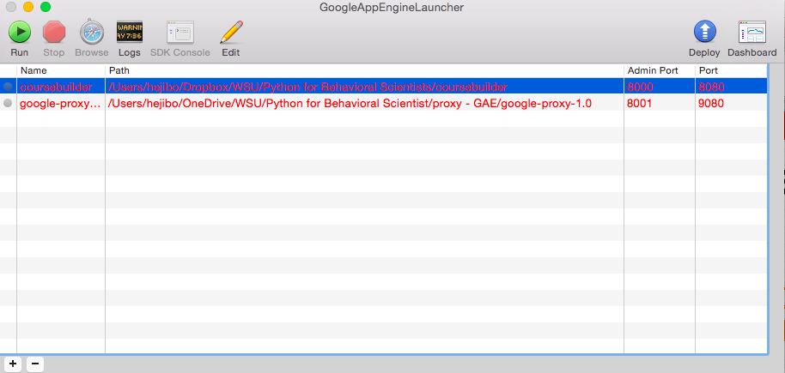
Setup GAE environment

Slide 7
Sign up GAE
Requirement:
- Have a Gmail account
Register link:
https://appengine.google.com

Slide 8
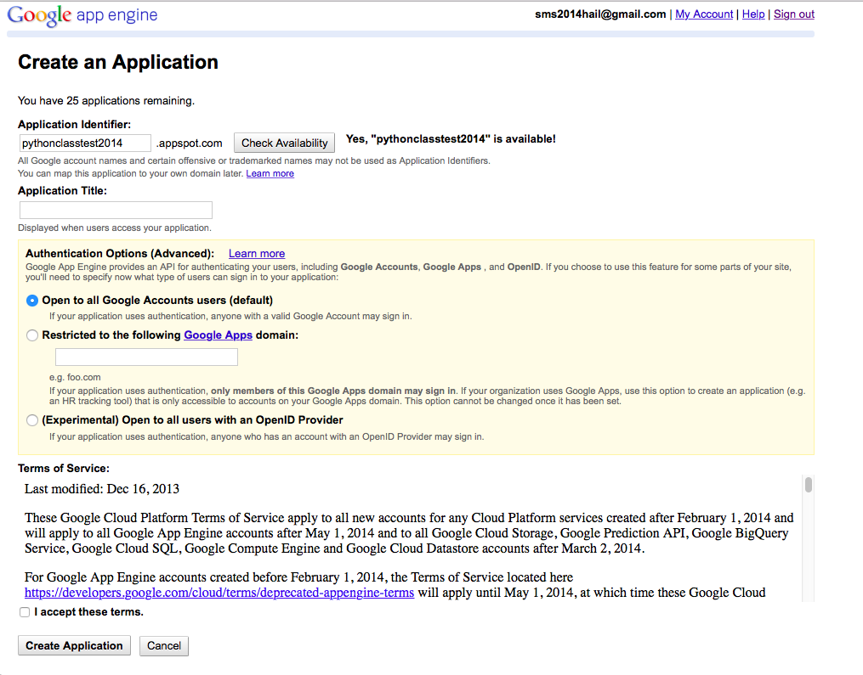
Create an application in GAE

Slide 9
Python SDK for GAE
https://cloud.google.com/appengine/docs/python/gettingstartedpython27/helloworld

Slide 10
Sign up GAE
Python SDK for GAE
https://cloud.google.com/appengine/docs/python/gettingstartedpython27/helloworld

Slide 11
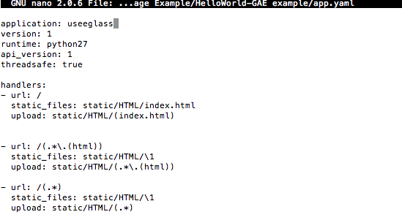
Creating the Configuration File

Slide 12

UPLOAD! HOORAY!

Slide 13
Thank You

